Slide 1

YouTube Trending Videos – Exploratory Data Analysis (EDA)
By
M. POOJITHA
Batch 434

Slide 2
INTRODUCTION
YouTube is one of the world’s largest video-sharing platforms, where millions of videos are uploaded and watched every day. Among these, only a small percentage reach the Trending section, which highlights the most popular and highly-engaged videos at a given time.
This project focuses on performing Exploratory Data Analysis (EDA) on the YouTube Trending Videos 2023 dataset to understand:
What type of content becomes popular?
How users engage with trending videos?
Which categories dominate the trending list?
How views, likes, and comments are distributed?
What role upload time plays in video performance?
By cleaning the dataset, handling missing values, detecting outliers, extracting time-based features, and visualizing patterns, this project uncovers meaningful insights about how videos gain popularity on YouTube.

Slide 3
PROBLEM STATEMENT
YouTube generates a massive amount of video content every day, but only a limited number of videos reach the Trending section, which highlights the most popular and highly-engaged videos on the platform. Understanding why certain videos trend while others don’t is a valuable problem for content creators, marketers, brands, and researchers.
However, the Trending algorithm is not publicly known, and video popularity depends on multiple factors such as views, likes, comments, category, upload time, and user interaction patterns.
Therefore, the challenge is to analyze the available data and identify the key factors that contribute to a video becoming popular.

Slide 4
The problem this project aims to address is:
👉 “What patterns, behaviors, and characteristics can be identified in YouTube Trending Videos, and how do these factors influence video popularity?”
To solve this problem, we need to:
Clean the raw dataset and prepare it for analysis
Understand engagement metrics (views, likes, comments)
Identify the most successful categories
Analyze the effect of upload timing
Detect outliers in video performance
Explore relationships between views, likes, and comments
Identify top-performing videos
Extract meaningful insights that explain why certain videos trend
This analysis will help uncover trends, patterns, and user behavior behind trending videos and provide insights into what type of content performs well on YouTube.

Slide 5
BASIC INFORMATION ABOUT THE DATASET
What is this dataset about?
This dataset contains information about YouTube videos that appeared in the Trending section in the year 2023.
These videos are the most popular and highly-watched videos on YouTube.
How many records does it have?
10,001 video entries.
Each entry represents one trending video.
What kind of information does each video contain?
Basic Details
Title of the video.
Channel name (who uploaded it).
Category (Music, Entertainment, News, etc.)

Slide 6
Engagement Metrics
Number of views.
Number of likes.
Number of comments.
Upload Information
Date and time of publishing.
Tags used.
Why is this dataset interesting?
Because trending videos show what people are actually watching, liking, sharing, and engaging with on YouTube.
By analyzing it, we can understand:
What type of videos become popular?
When creators should upload videos?
Which categories perform well?
What makes a video go viral?

Slide 7
Dataset Information
Checking the number of rows and columns:
df.shape # Tells how many rows and columns the dataset has
Viewing first few records:
df.head() # Shows the first 5 rows of the dataset
Getting complete information about each column:
df.info()
Shows column names.
Shows datatypes(int, float, object, datetime).
Shows how many non null values are present.
Helps detects missing values.

Slide 8
Getting statistical summary of numeric columns:
df.describe()
Gives useful statistics such as:
Minimum
Maximum
Average
Checking missing values:
df.isnull().sum() # Shows number of missing values in each column
Checking duplicate rows:
df.duplicated().sum() # Shows how many repeated rows exist
Viewing all column names:
df.columns # Useful for understanding dataset structure

Slide 9
DATA CLEANING STEPS
Removing Duplicate Rows:
df = df.drop_duplicates()
Handling missing values:
df['column_name'] = df['column_name'].fillna(value)
Convert Data Types:
df['column'] = df['column'].astype(int)
df['date_column'] = pd.to_datetime(df['date_column’])
Rename Columns (if needed):
df = df.rename(columns={"old_name": "new_name"})
Handle Outliers (IQR Method):
Q1 = df['column'].quantile(0.25)
Q3 = df['column'].quantile(0.75)
IQR = Q3 - Q1
lower_limit = Q1 - 1.5 * IQR
upper_limit = Q3 + 1.5 * IQR
outliers = df[(df['column'] < lower_limit) | (df['column'] > upper_limit)]

Slide 10
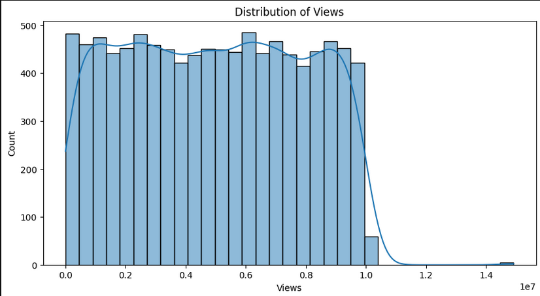
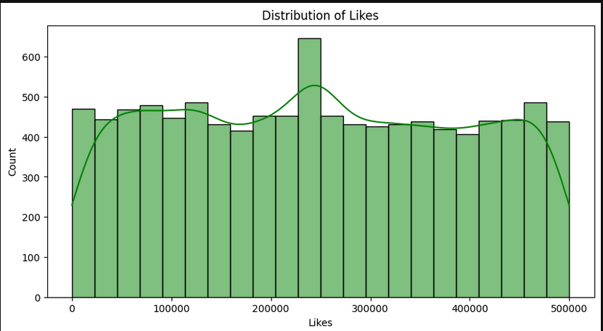
Univariate Analysis
Distribution of views Distribution of likes

Slide 11
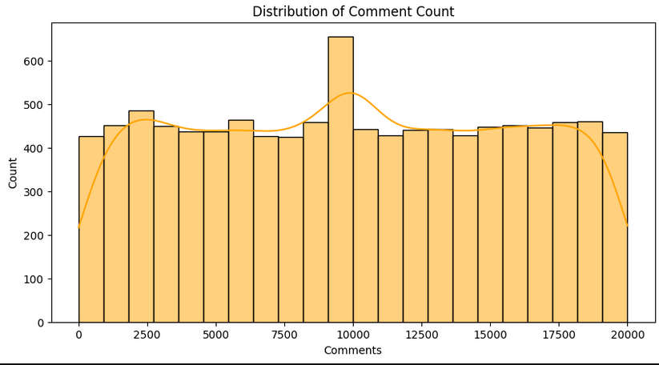
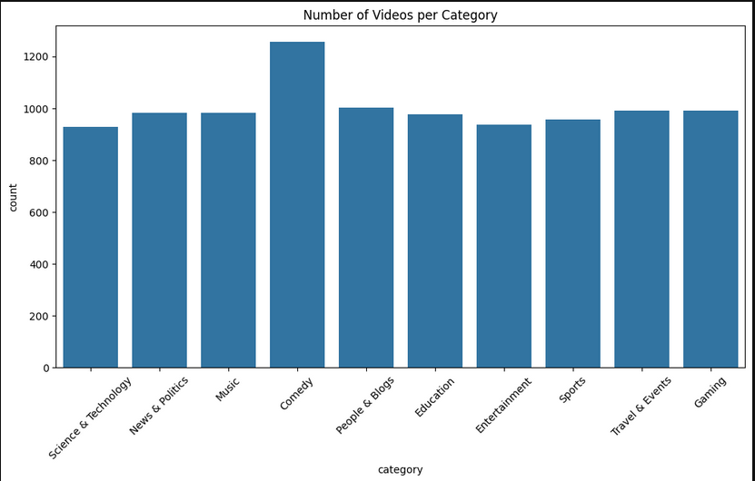
Distribution of Comment count Number of videos per category

Slide 12
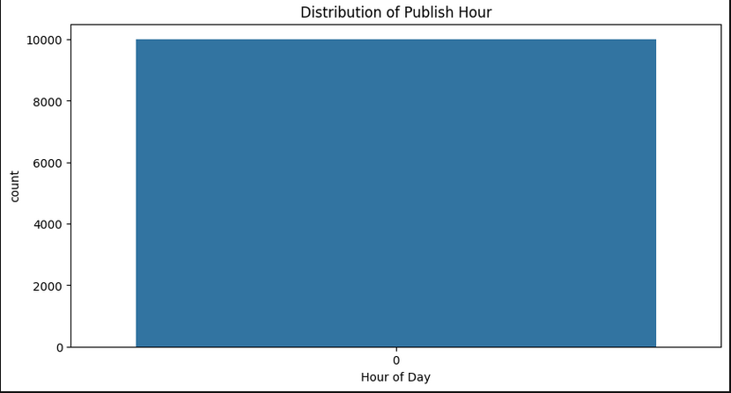
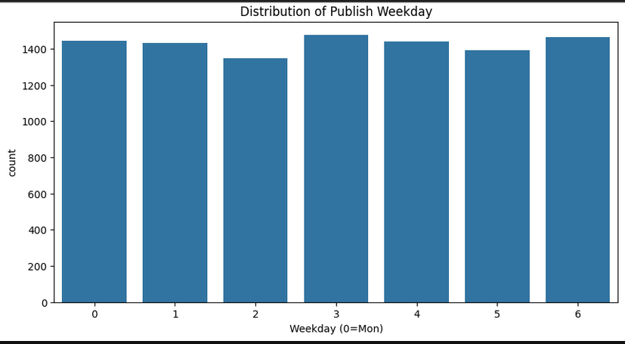
Distribution of Publish Hour Distribution of Publish Weekday

Slide 13
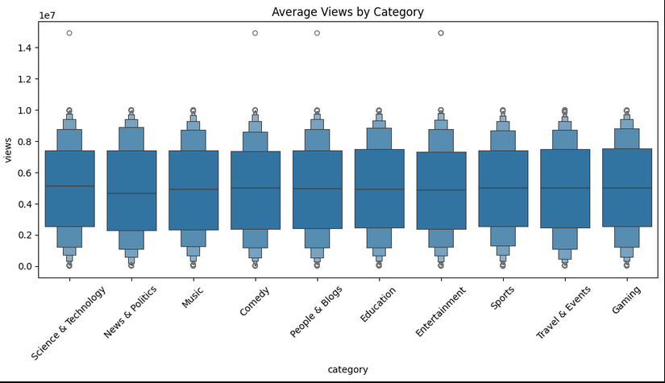
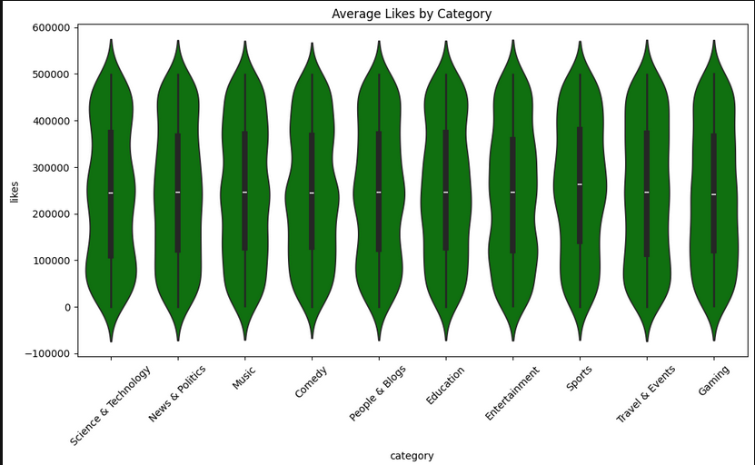
Bivariate Analysis
Average Views by Category Average Likes by Category

Slide 14
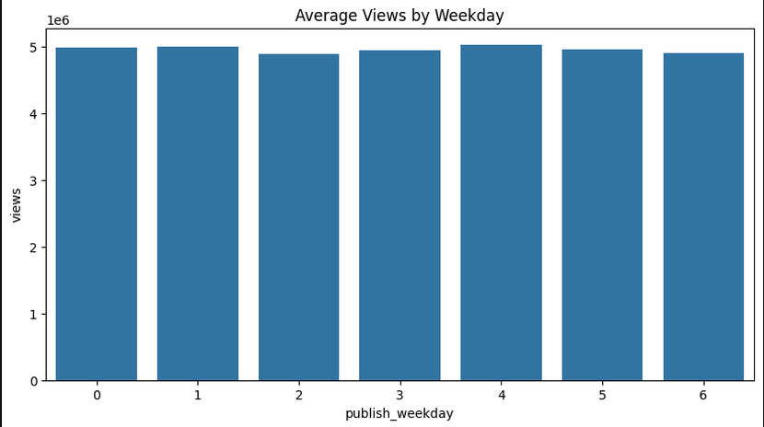
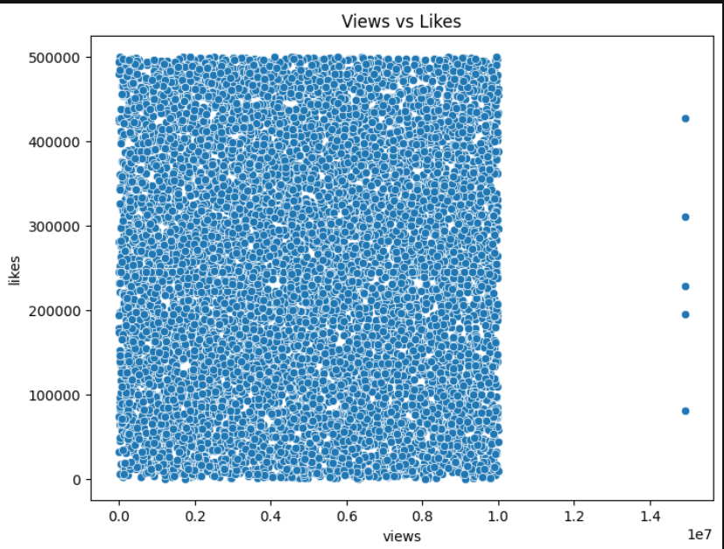
Average views by Weekdays Views VS Likes

Slide 15
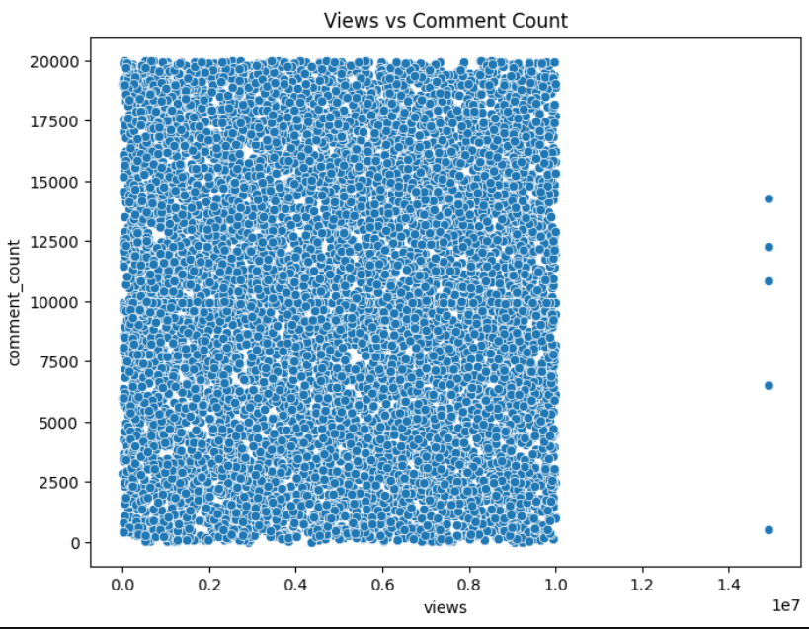
Views vs Comment Count

Slide 16
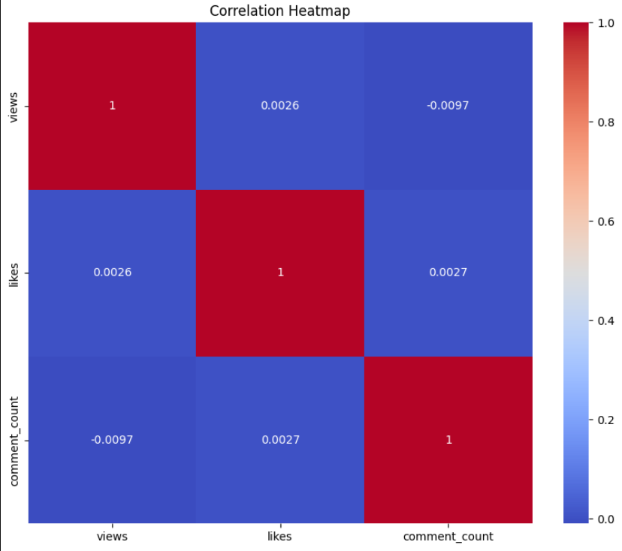
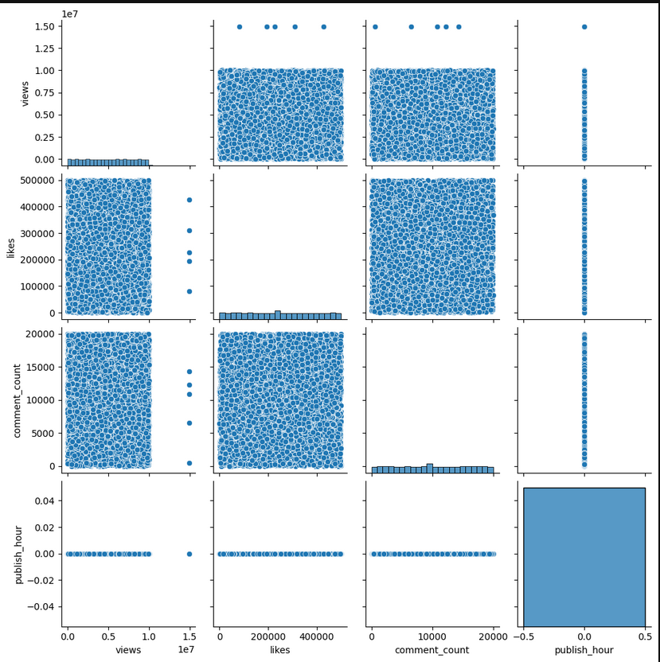
Multivariate Analysis
Correlation Heatmap Pair plot

Slide 17
Univariate Analysis – Views Distribution
Histogram and KDE plots show:
Observations:
Views are right-skewed.
Most videos get low-to-medium views.
Few videos reach extremely high views → viral videos.
Distribution confirms natural popularity curve.
Univariate Analysis – Likes Distribution
Insights:
Likes follow a similar right-skewed pattern.
Majority of videos get moderate likes.
Viral videos receive exceptionally high likes.
Univariate Analysis – Likes Distribution
Insights:
Likes follow a similar right-skewed pattern.
Majority of videos get moderate likes.
Viral videos receive exceptionally high likes.

Slide 18
Univariate Analysis – Comments
Insights:
Comments distribution is very skewed.
Most videos have limited comments.
Only a few videos have extremely high comments.
This correlates with viewership and engagement levels.
Category Distribution (Countplot)
Insights:
“Entertainment”, “Music”, “People & Blogs”, and “News & Politics” dominate trending
Certain niches like “Education” and “Travel” appear less often
YouTube trending section favors high-engagement categories
Publish Hour Distribution
Insights:
Most videos are published between 12 PM to 8 PM.
Evening uploads seem to get more engagement.
Early morning hours have very low publishing frequency.

Slide 19
Publish Weekday Distribution
Insights:
Videos trend across all days.
Weekends (Saturday-Sunday) show a slight drop.
Weekdays have more uploads and engagement.
Bivariate Analysis – Views vs Likes
Insights:
Strong positive correlation.
As views increase, likes also increase.
Indicates high user engagement.
Views vs Comment Count
Insights:
Positive correlation is visible.
Videos with high views naturally attract more comments.
Category vs Views (Boxen Plot)
Insights:
“Entertainment” & “Music” have the highest median views
Some categories have very wide spread → Viral potential

Slide 20
Category vs Likes (Violin Plot)
Insights:
Likes follow similar trends to views.
Entertainment category tops engagement.
Time Features – Average Views by Hour
Insights:
Videos posted between 4 PM – 7 PM receive highest average views.
Late night/early morning uploads get low engagement
Average Views by Weekday
Insights:
Monday & Tuesday have high engagement.
Weekend views drop slightly.
Best days to post videos: Monday, Wednesday, Friday

Slide 21
Multivariate Analysis:
Correlation Heatmap
Insights:
Views ↔ Likes → Strong positive relation
Views ↔ Comments → Strong relation
Time-based features have weaker correlations
Engagement metrics strongly impact popularity
Pairplot Analysis
Shows combined relationships:
Cluster pattern between views, likes, comments.
High consistency among engagement columns.
Confirms earlier conclusions

Slide 22
Summary
Highly skewed engagement patterns.
Top categories: Entertainment, Music.
Best upload time: Evening hours.
Best weekdays: Midweek days.
Likes & comments strongly tied to popularity.
Trending section favors fast-engaging videos

Slide 23
Conclusion
Successfully cleaned & analyzed a large real-world dataset
Extracted time-based behavioral insights
Identified trending patterns and engagement relationships

Slide 24
THANK YOU

